Slide 1
How does a bike-share navigate speedy success?
Cyclistic
March 2025

Slide 2
Business Task
Understand how annual members and casual riders use Cyclistic bikes differently to create marketing strategies that convert casual riders into annual members.

Slide 3
Data Sources
Historical trip data from Divvy Trip Data.
Particularly used the Divvy 2019 Q1 dataset.
Data includes ride details (id, timestamps, user type, bike type, stations, user details, trip duration, etc).
Public dataset without personally identifiable information.

Slide 4
Data Cleaning
Removed missing values from necessary columns & duplicates to ensure data integrity.
Standardized time formats and extracted day of the week.
Created new columns: ride_length = end_time – start_time day_of_week = Extracted from start_time
Filtered outliers and sorted the columns according to start_time.

Slide 5
Visualizations & Key Findings (spreadsheets)
Subscribers take significantly more rides throughout the week, while casual riders (customers) have fewer rides, with a slight increase over weekends.

Slide 6
Visualizations & Key Findings (spreadsheets)
Casual riders (customers) have much longer ride durations, especially on weekends, while subscribers maintain relatively shorter and consistent ride lengths across all days.

Slide 7
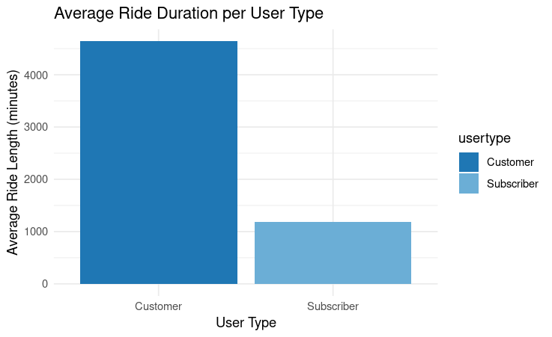
Visualizations & Key Findings (R programming)
Casual riders (Customers) take significantly longer rides on average compared to annual members (Subscribers), indicating that they likely use the service for leisure rather than commuting.

Slide 8
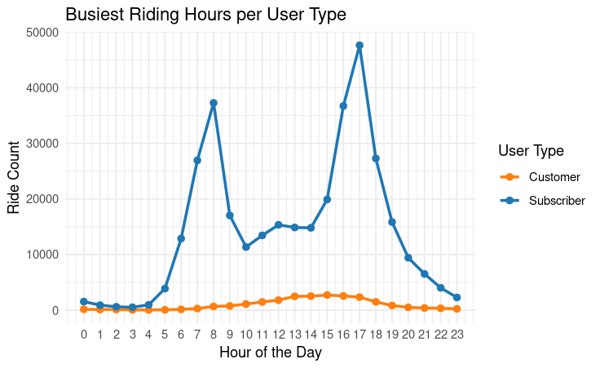
Visualizations & Key Findings (R programming)
Subscribers have two peak riding times—morning (7-9 AM) and evening (4-6 PM)—suggesting work commutes, while Customers have a more even distribution, likely using bikes for recreation throughout the day.

Slide 9
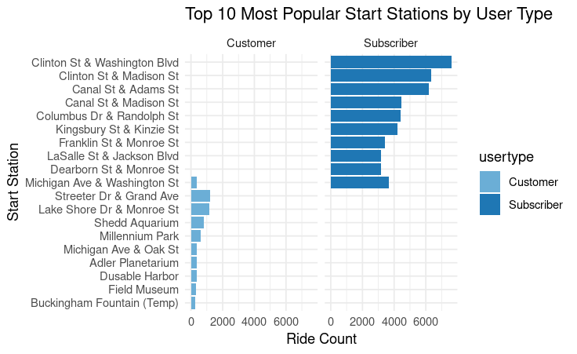
Visualizations & Key Findings (R programming)
Annual members start rides mainly at transit hubs and office-dense areas, while casual riders begin rides near recreational locations, suggesting different primary use cases for the service.

Slide 10
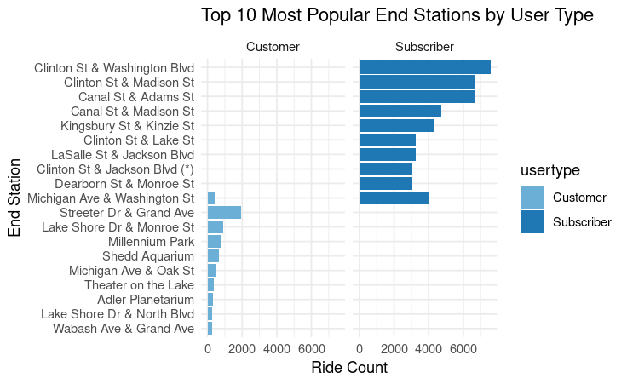
Visualizations & Key Findings (R programming)
Annual members frequently end rides at key transit and business locations, whereas casual riders tend to end their rides at popular tourist spots and parks.

Slide 11
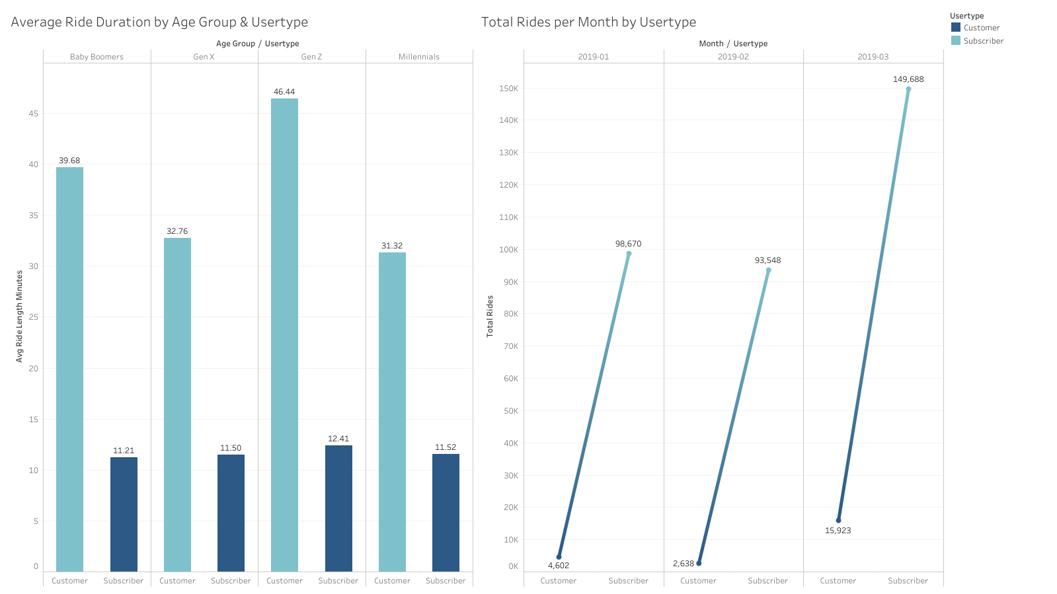
Visualizations & Key Findings (SQL and Tableau)
Casual riders have significantly longer ride durations than subscribers across all age groups, with Gen Z riding the longest, while subscribers maintain a consistent ride duration of around 11-12 minutes.
Subscribers dominate total ride counts each month, showing a steady increase over time, while casual riders contribute far fewer rides.

Slide 12
Analysis Summary
Subscribers ride more on weekdays, peaking during commuting hours, while casual riders prefer weekends with longer ride durations.
Subscribers start/end trips near transit hubs, while casual riders prefer recreational and tourist areas.
Gen Z casual riders have the longest ride durations, while subscribers maintain stable times.
Subscribers make up the majority of rides, with consistent growth over time.

Slide 13
Recommendations
Weekend/Tourist Membership Plan: Offer discounted weekend or seasonal passes to attract leisure riders.
Targeted Promotions: Market memberships at tourist spots, parks, and recreation areas.
Incentivize Commuting: Provide discounted commuter plans to encourage casual riders to switch to weekday usage.

Slide 14
Further Exploration
Why would casual riders buy Cyclistic annual memberships?
How can Cyclistic use digital media to influence casual riders to become members?

Slide 15
Thank you

